Slide 1

Multimedia SoC Design
Jan. 22, 2021
Feature-Based Image Morphing Accelerator on PYNQ
Presenter: Tang Lee, I-Ting Lin, Cheng-Yan Du
Graduate Institute of Electronics Engineering, National Taiwan University
Github: https://github.com/MRdudu156/MSOC_2020_FINAL_Project_group7/tree/main

Slide 2
Outline
Introduction
Algorithm
System Architecture
Kernel Optimization with Vivado HLS
Implementation Result
Summary

Slide 3
Outline
Introduction
Feature-based Image Morphing
Algorithm
System architecture
Kernel Optimization with Vivado HLS
Implementation Result
Summary

Slide 4
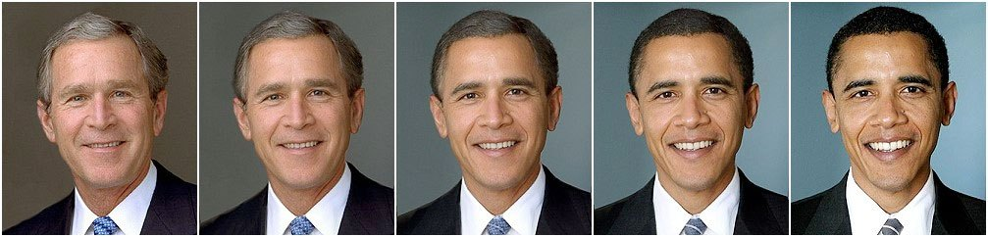
Introduction
Image morphing is a special effect in motion pictures or animations
Changes one image into another through a seamless transition
Source image
Target image
Destination image

Slide 5
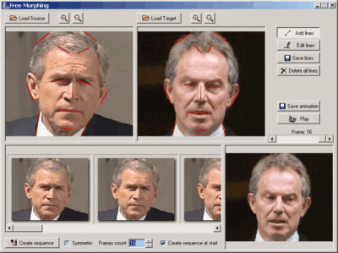
Introduction
Widely used in animations, advertisements or movies
Lots of Apps provide morphing special effects

Slide 6
About The Project
This final project contains:
Software (Python & MATLAB) implementation of image morphing algorithm
For hardware verification
Integrated with host program run on PYNQ platform
Hardware implementation
Implement the image morphing algorithm in C++
Synthesized by Xilinx’s High-Level Synthesis (HLS) tool
The whole system is built by Xilinx’s Vivado design suite and run on PYNQ platform in Zedboard

Slide 7
Outline
Introduction
Algorithm
System Architecture
Kernel Optimization with Vivado HLS
Implementation Result
Summary

Slide 8
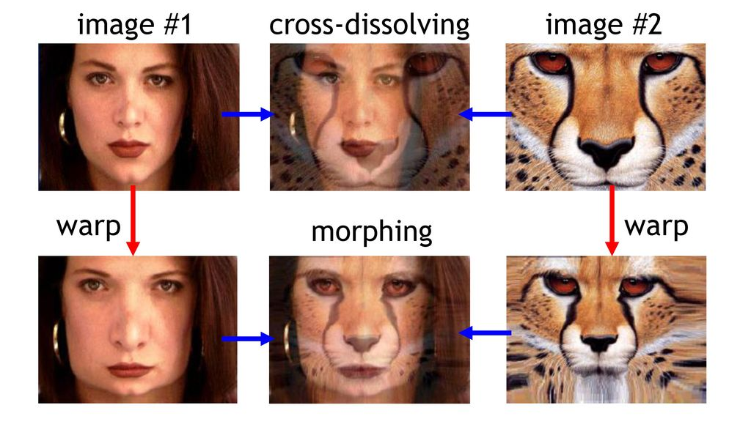
Algorithm
Feature-based image morphing consists of two steps
Pre-warp the two images
Align features that appear in both images
Reposition all pixels in the source & destination images
Cross-dissolve their color
A weighted combination of two images, pixel-by-pixel
Requires lots of computation

Slide 9
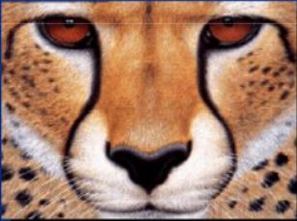
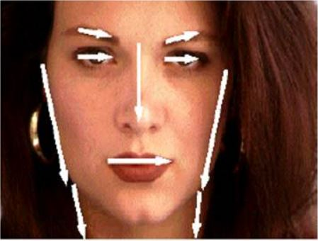
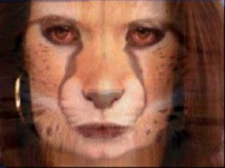
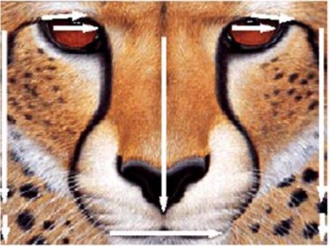
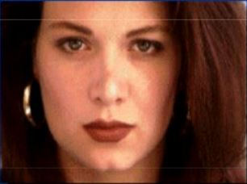
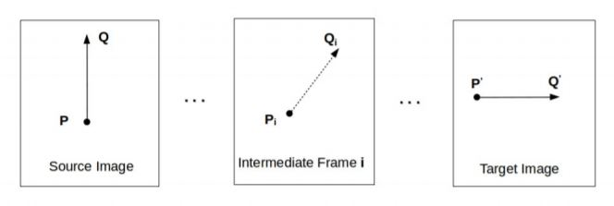
Warping (1/2)
Beier-Neely algorithm
Feature-based morphing
Specify feature line-segment
Source image
Target image
Destination image
Linear line-segment interpolation Lt

Slide 10
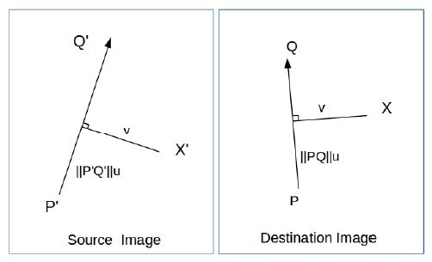
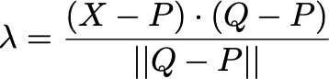
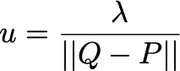
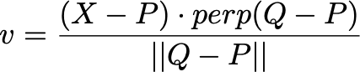
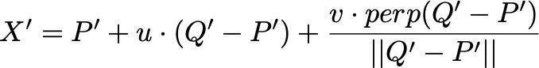
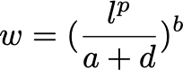
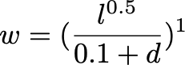
Warping (2/2)
After warping, relative position of each pixel & feature lines in target image remains the same as in source image
Mapping function
Source image
Target image

Slide 11
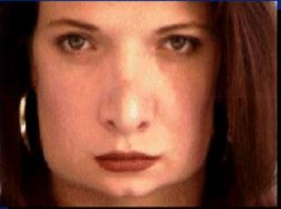
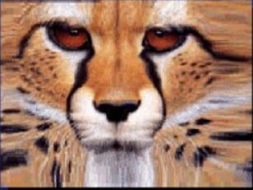
Blending
Linearly interpolate the warped source & warped destination images
Warped image 1
Morphed result
Warped image 2

Slide 12
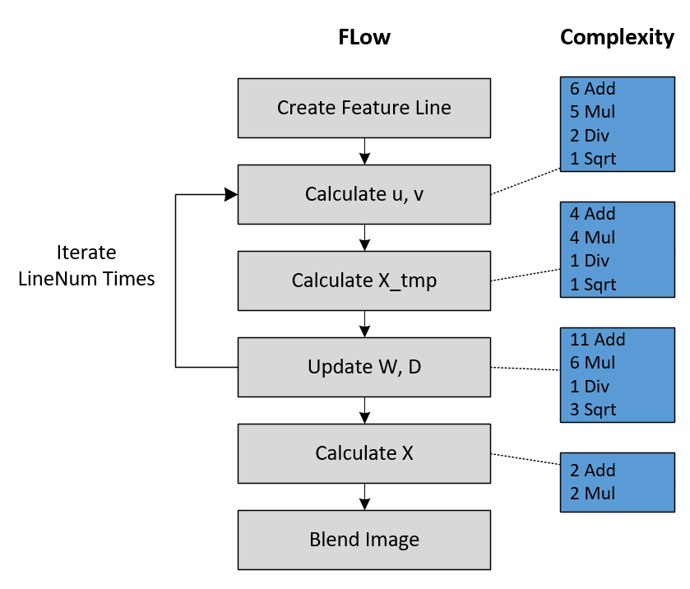
Algorithm Flow
Image size: 256x256
Feature line number: 8
Total complexity (32float operation)
23.9M FLOP
11.1M additions
7.99M multiplications
2.10M divisions
2.62M square root
Iterate
LineNum times
Iterate for 65536 pixels
Notes:
FLOPs: normalize to multiplication
Add = 0.5 mul
Mul = 1 mul
Div = 6 mul
Sqrt = 12.5 mul
The total complexity is for one image

Slide 13
Outline
Introduction
Algorithm
System Architecture
Kernel Optimization with Vivado HLS
Implementation Result
Summary

Slide 14
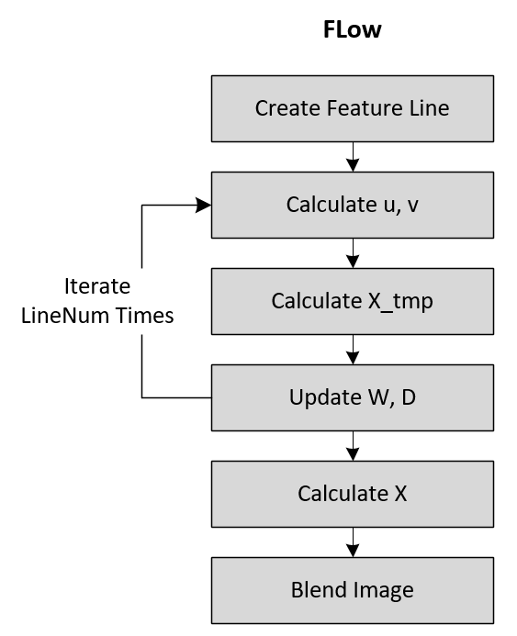
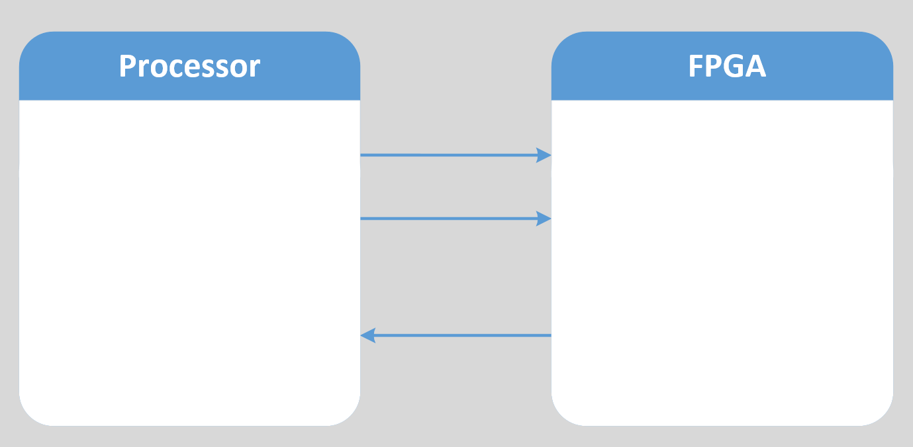
System Flow
Host
Create feature line
Blending
Output GIF
Control signal
Image morphing
Return image map
Line info
image map
Kernel
Host

Slide 15
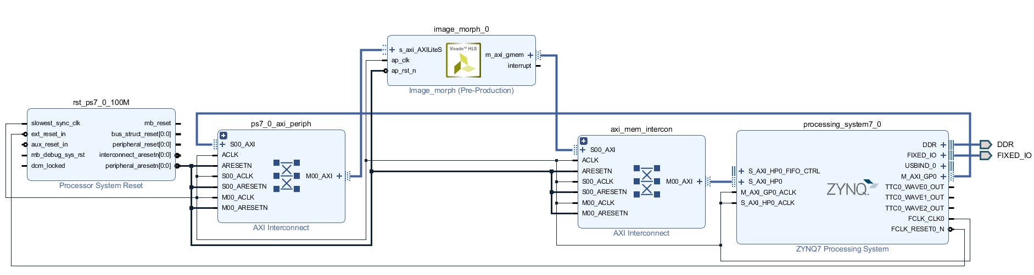
System Block Diagram
Zedboard@100MHz
Input and output data interface: AXI4
Control register interface: AXI4-Lite
Data width is 32 bit

Slide 16
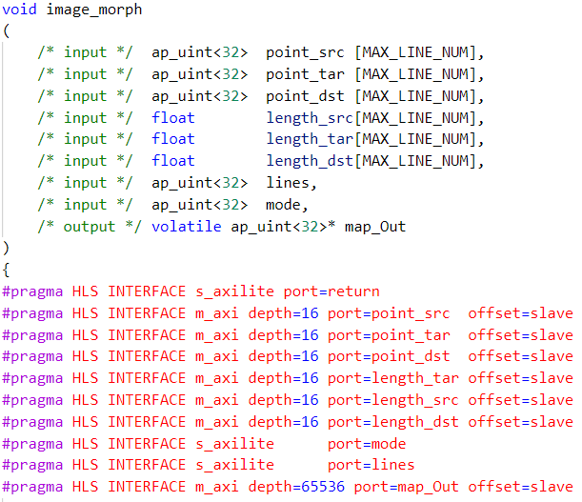


I/O Interface
Line information
Control signal
Output image map
AXI for I/O data
AXI-Lite for control signal

Slide 17
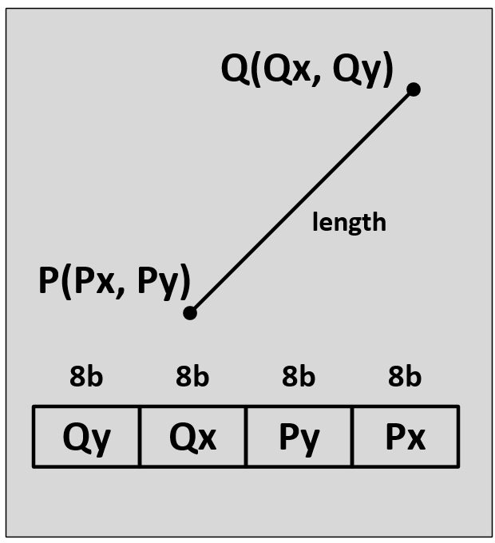
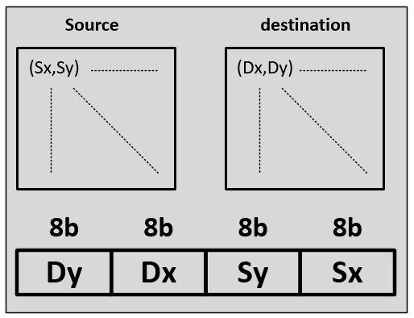
I/O Packing
Pack data together to make full use of bus bandwidth
One coordinate should be represented by two uint8 numbers
Line segment information
Wrap the two endpoint coordinates together
Point: 32-bit unsigned integer
Length: 32-bit float
Morphed image map
Wrap source coordinates with dst coordinates
Point: 32-bit unsigned integer

Slide 18
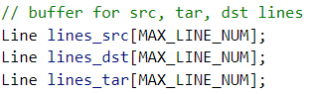
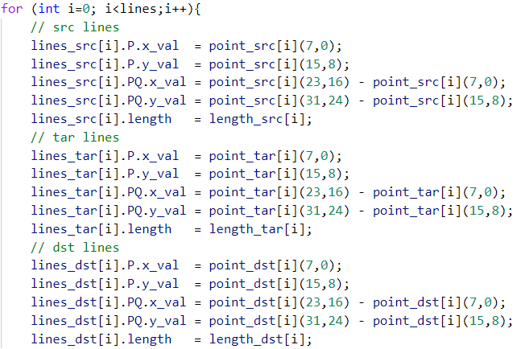
I/O Packing

Slide 19
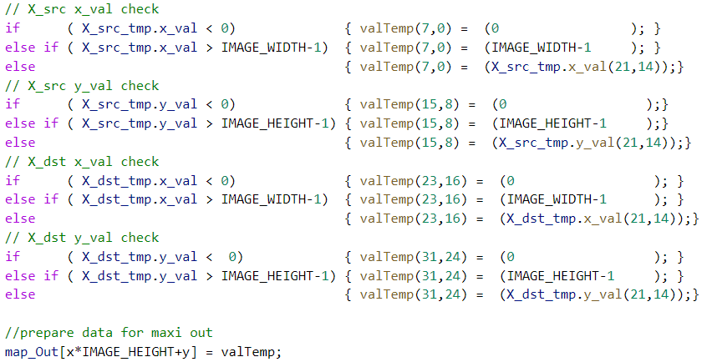
I/O Packing

Slide 20
Outline
Introduction
Algorithm
System Architecture
Kernel Optimization with Vivado HLS
Implementation Result
Summary

Slide 21
Kernel Optimization
Four versions of kernel implementation
Solution 1: Floating-point representation
Solution 2: Pipeline pragma
Solution 3: Fixed-point representation
Solution 4: Look-up table division

Slide 22
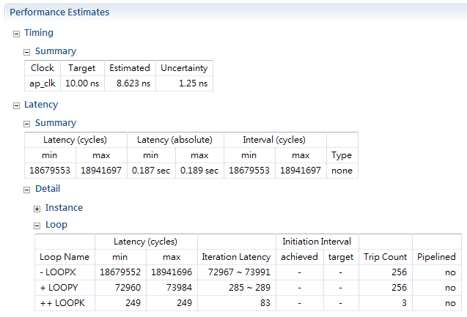
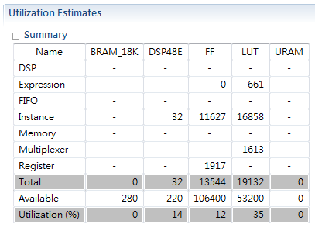
Solution 1: Floating-point Representation
All vectors and lengths are represented by 32-bit FP.
Floating-point adders, multipliers, dividers, and fsqrt are synthesized.
Target clock period is set to 10.00 ns.
Total latency is about 188 ms.

Slide 23
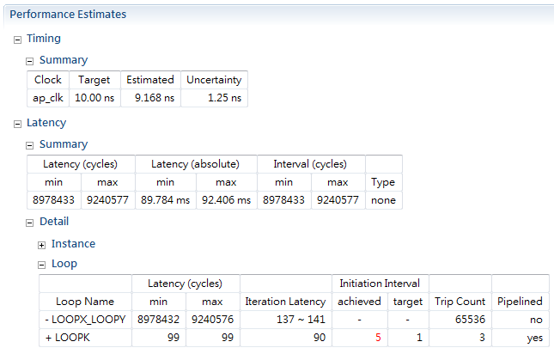
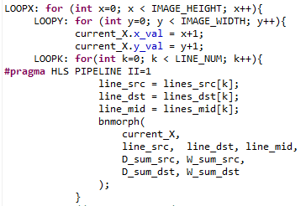
Solution 2: Pipeline Pragma
Add PIPELINE pragma to the innermost feature line loop, and use INLINE pragma to make sub-functions under the effect of PIPELINE.
Different feature lines can be processed at the same time.
Latency is reduced from 188 ms to 90 ms (52% reduction).
II=5

Slide 24
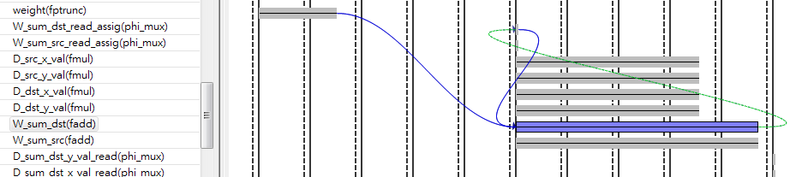
Solution 2: Pipeline Pragma
Initiation interval is limited by 5-cycle floating-point addition.
Timing doesn’t meet the target clock period.

Slide 25
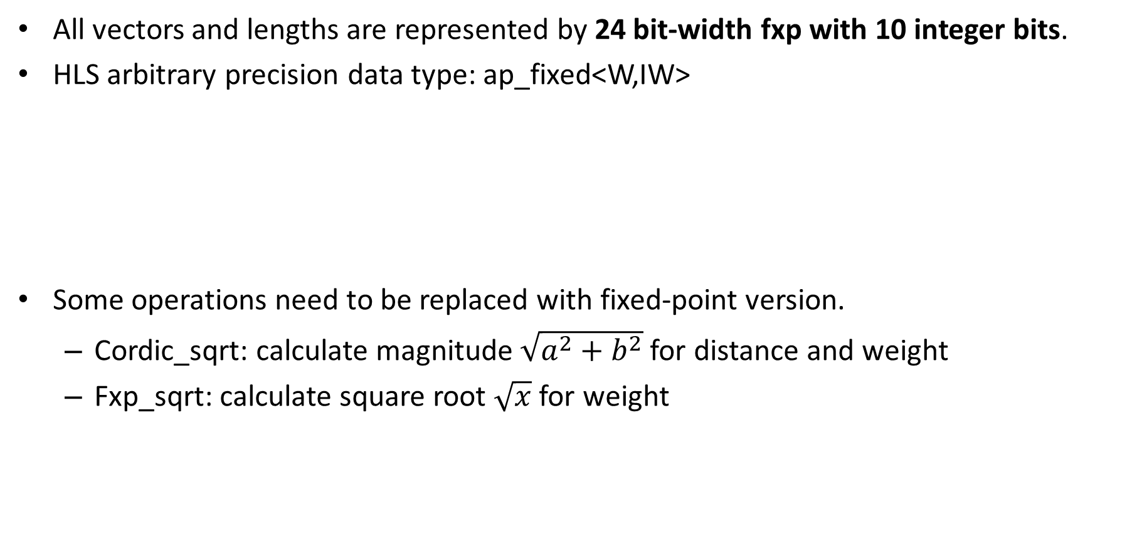
Solution 3: Fixed-point Representation
All vectors and lengths are represented by 24 bit-width fxp with 10 integer bits.
HLS arbitrary precision data type: ap_fixed<W,IW>
Some operations need to be replaced with fixed-point version.
Cordic_sqrt: calculate magnitude $\sqrt{a^{2}+b^{2}}$ for distance and weight
Fxp_sqrt: calculate square root $\sqrt{x}$ for weight
Integer (10-bits)
Fraction (14-bits)
0 | 1 | …… | 1 | 1 | 0 | 1 | …… | 1 | 0

Slide 26
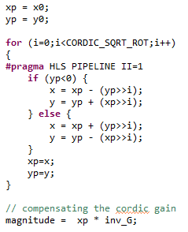
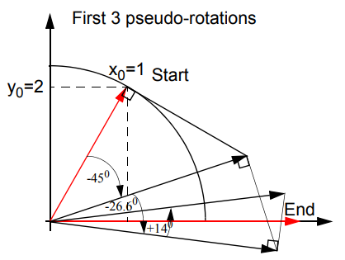
Solution 3: Fixed-point Representation
Cordic_sqrt (source: https://github.com/Xilinx/HLx_Examples)
We adopt CORDIC vector mode for computing magnitude.
Replace rotation multiplications with simple shift-and-add operation.
Iteratively rotates the initial vector (x, y) to x-axis.
Decision by the sign of y
Pseudo-rotations
Scaling factor

Slide 27
Solution 3: Fixed-point Representation
Fxp_sqrt (source: ~Xilinx/Vivado/2019.2/examples/design)
Non-restoring square root algorithm
The square root is generated digit-by-digit.
1 0 0 1 .
Square root result
q = (q_{3,} q_{2,} q_{1,} q₀)
01 01 11 01 . 00
Square root digit
- 1
Guess q₃ = 1
00 01
Positive partial remainder
q₃ = 1
q⁽¹⁾ = 1
- 1 01
Subtract (q⁽¹⁾ 01)
11 00 11
Negative partial remainder
q₂ = 0
q⁽²⁾ = 10
+10 11
Add (q⁽²⁾ 11)
11 11 10 01
Negative partial remainder
q₁ = 0
q⁽³⁾ = 100
+ 1 00 11
Add (q⁽³⁾ 11)
1 00 00 11 00
Overflow
q₀ = 1
q⁽⁴⁾ = 1001
Notes:
Dividend每次均用兩個bit檢查

Slide 28
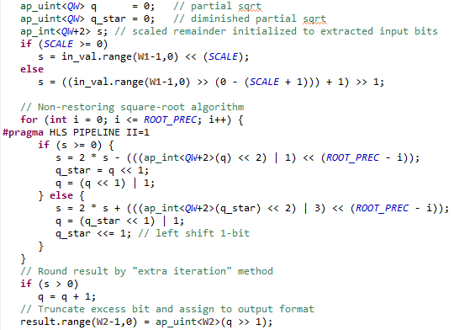
Solution 3: Fixed-point Representation
Fxp_sqrt (source: ~Xilinx/Vivado/2019.2/examples/design)
Non-restoring square root algorithm
The iteration process can be pipelined.
Positive partial remainder, Subtract (q^{(i)} 01)
Negative partial remainder, Add (q^{(i)} 11)

Slide 29
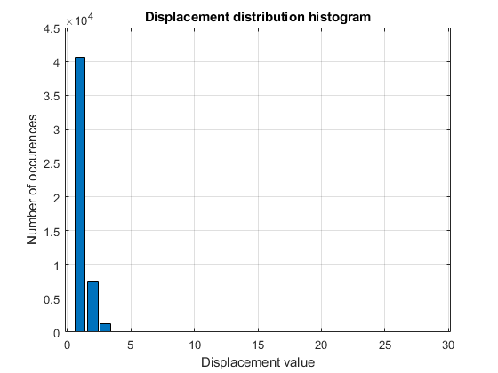
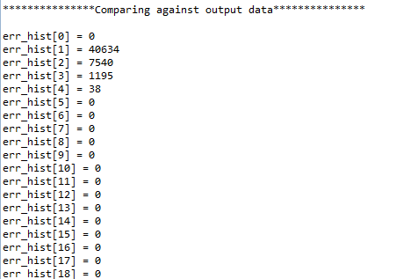
Solution 3: Fixed-point Representation
We test the accuracy by c-sim and compare with the result of floating-point version.
From the coordinate displacement histogram, we can find that most of the pixels displace from the correct coordinates by 1 to 3 pixels.
Small displacements won’t affect the morphed result too much.
Most of the displacements are small enough

Slide 30
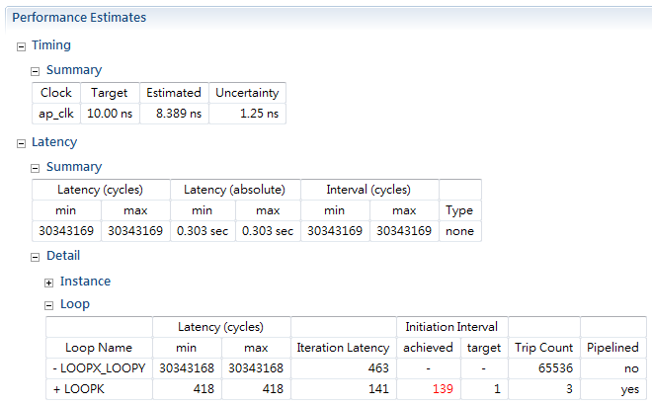
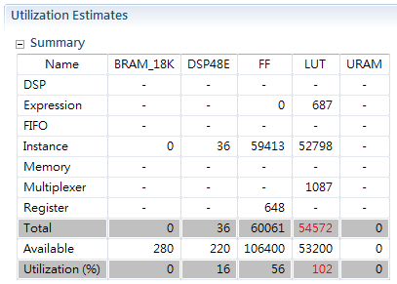
Solution 3: Fixed-point Representation
All vectors and lengths are represented by 24 bit-width fxp with 10 integer bits.
With pipelining, the latency is about 303 ms (worse than solution 1).
Initiation interval becomes too large.
The LUT resource requirement is unaffordable.
II=139
LUT resource is overflow

Slide 31
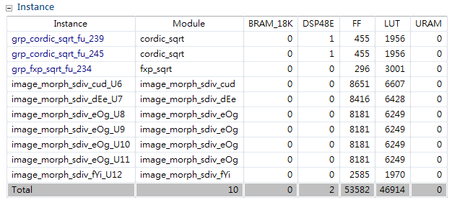
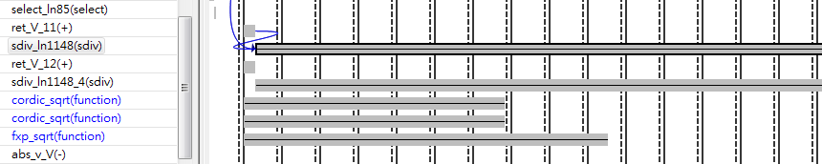
Solution 3: Fixed-point Representation
Fixed-point division is the bottleneck
About 80 cycles are required
Consume most of the resource
The cost of direct division is too high.

Slide 32
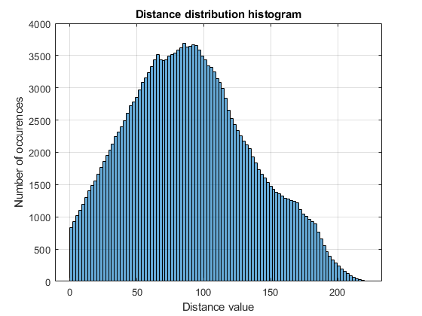
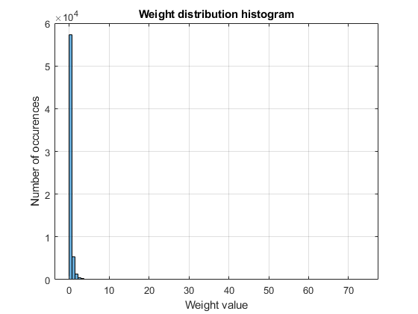
Solution 4: Look-up Table Division
Replace the division operations with look-up table
Division by distance/length of feature lines
Division by weight
MATLAB simulation shows the distribution histogram.
The suitable range and precision of LUT can be decided.
Most of the weights are small values
=> Higher precision requirement
Distance distributes over (0, 256)
Weight distributes over (0, 80)

Slide 33
Solution 4: Look-up Table Division
The division is replaced by multiplication with the reciprocal of denominator.
Precision requirement
Division by distance/length of feature lines: range(0,2⁹) with precision 2⁽⁻³⁾
Division by weight: range(0,2⁶) with precision 2⁽⁻⁶⁾
Numerator x
Feature line length
Distance LUT
4 | 0.250
8 | 0.125
Result = x/y
Distance from pixel to feature line
y
1/y
Numerator x
Weight LUT
2.0 | 0.500
2.5 | 0.400
Weight
Result = x/y

Slide 34
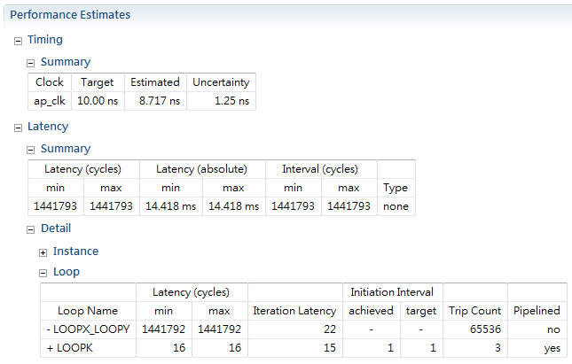
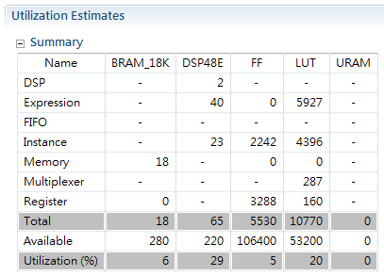
Solution 4: Look-up Table Division
Replace the division operations with look-up table
Latency is significantly reduced to 14.4 ms.
Resource requirement is greatly reduced.
LUT is implemented using BRAM on board.
II=1
BRAM for look-up table

Slide 35
Selected Mirco-Architecture
Solution 4 (fxp with LUT division) achieves the shortest latency with affordable hardware resource.
Thus, we adopt solution 4 for further implementation on board.
 |  | Solution 1 | Solution 2 | Solution 3 | Solution 4
Latency (ms) |  | 188.0 | 90.0 | 303.0 | 14.4
Resource (%) | LUT | 35 | 33 | 102 | 20
 | FF | 12 | 13 | 52 | 5
 | DSP48E | 14 | 12 | 16 | 29
 | BRAM_18K | 0 | 0 | 0 | 6

Slide 36
Outline
Introduction
Algorithm
System Architecture
Kernel Optimization with Vivado HLS
Implementation Result
Summary

Slide 37
Comparison
Compare our design with CPU: Intel i7-6700 @3.4GHz
Image size = 256x256
Number of feature lines = 8
Task: generate a sequence of morphed images (total 11 images)
 | Our system (PYNQ + Zedboard) | CPU (Python program)
Operating frequency (Hz) | 100M (kernel) | 3.4G
Latency (s) | 1.29 | 406
Throughput (morphed img./s) | 8.5 | 0.03
315x speed up!

Slide 38
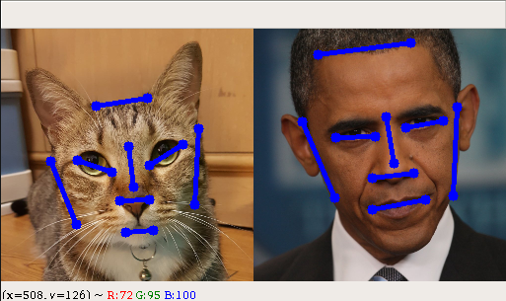

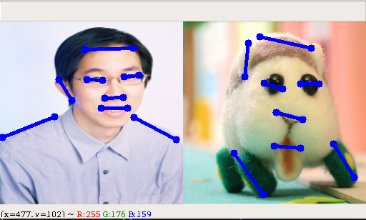

Demo

Slide 39
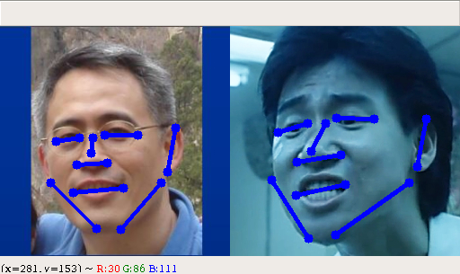



Demo

Slide 40
Outline
Introduction
Algorithm
System Architecture
Kernel Optimization with Vivado HLS
Implementation Result
Summary

Slide 41
Summary
Feature-based image morphing is introduced
A special effect widely used in animations, movies, etc.
Image morphing consists of two major steps: Warping and Blending
Warping requires lots complex computation such as square root and division
Warping allows pixel-level parallelism which is suitable for hardware acceleration
An optimized micro-architecture of kernel function is designed under several analysis
24-bit fixed-point datatype
CORDIC for magnitude computation & Non-restoring square-root algorithm
Division is replaced by LUT
Implementation result is compared with Python program run in Intel i7-6700 CPU
315x speed up for generating a morphed images sequence

Slide 42
Reference
[1] Feng Zhu, “Image Morphing with the Beier-Neely Method,” B.Sc., Northwestern Polytechnical University, 2013.
[2] https://www.xilinx.com/support/documentation/sw_manuals/xilinx2018_3/ug902-vivado-high-level-synthesis.pdf
[3] T. Sutikno, “An efﬁcient implementation of the non restoring square root algorithm in gate level,” technology, vol. 1, no. 3, pp. 5–10, 2011.

